Slide 1
ASP.NET MVC
Lesson 4 Writing Data

Slide 2
Writing Data
Create
Read (lesson 3)
Update
Delete
Get ⬄ Post
SelectList - ViewData

Slide 3
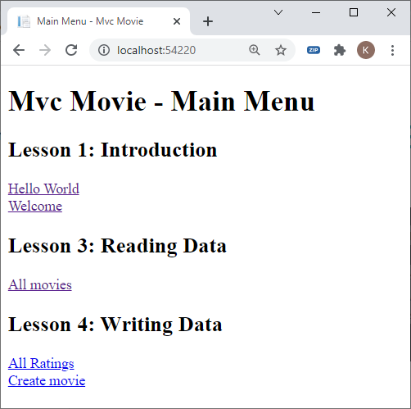
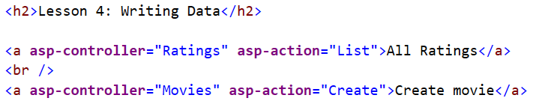
MVCMovie - Home/Index.cshtml

Slide 4
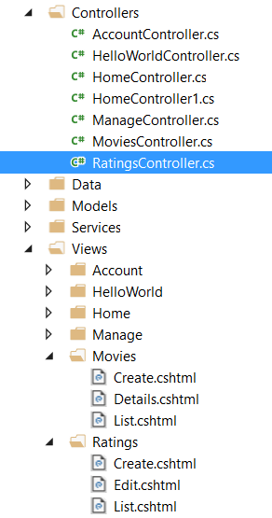
Ratings Crud (resources)
Controllers
RatingsController.cs
Views
Ratings
Create.cshtml
Edit.cshtml
List.cshtml
Movies
Create.cshtml

Slide 5
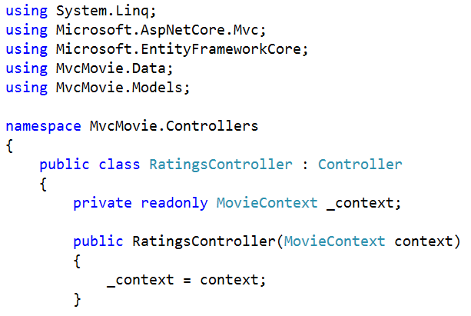
Ratingscontroller.cs

Slide 6
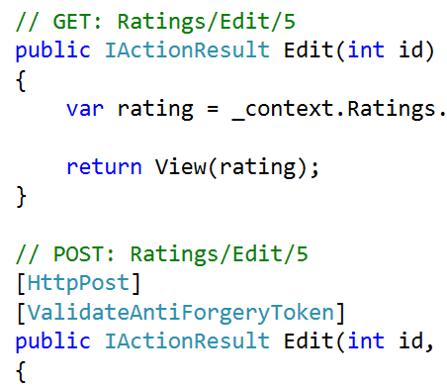
Get ⬄ POst
GET-method
is executed when a hyperlink is clicked
<a href="/Ratings/Create">Create</a>
<a href="/Ratings/Edit/1">Edit</a>
POST-method
is called at form submission (default = post)
<form action="/Ratings/Create" method="post">
<form action="/Ratings/Edit/1" method="post">

Slide 7
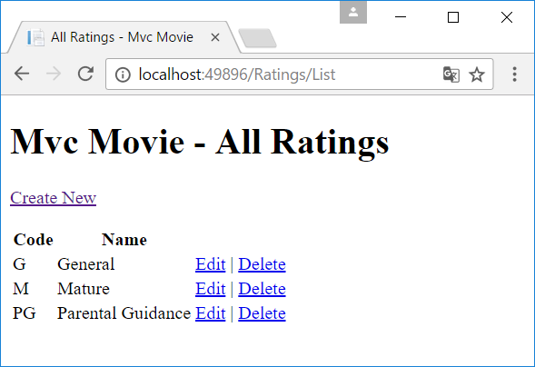
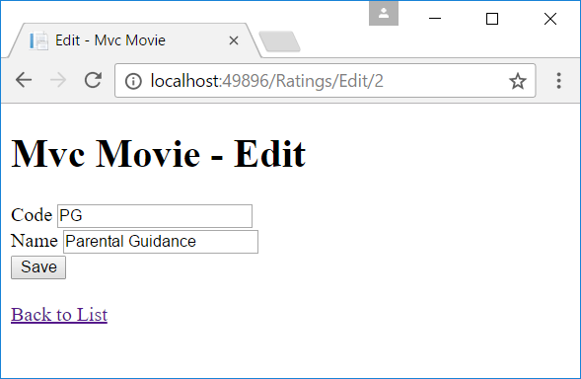
RatingsController Methods
List
List
Get: list all ratings
Create
Get: show form to input new rating data
Post: add new rating to the database after submitting the form
Edit
Get: retrieve rating data to be modified in the form
Post: write modified data to the database
Delete
Get: delete the selected rating
Edit (Get)
Edit (Post)

Slide 8
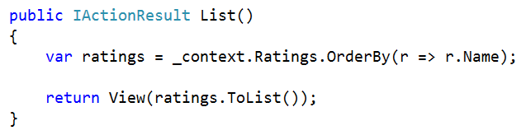
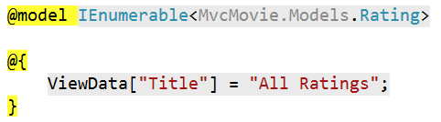
List

Slide 9
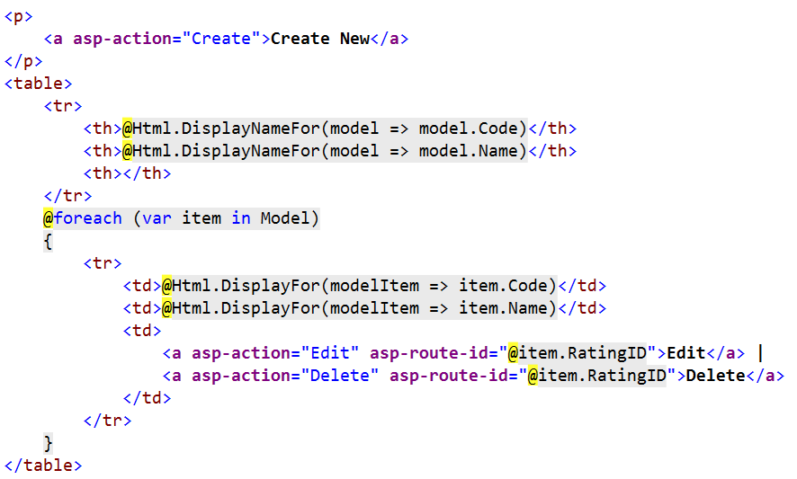
List

Slide 10
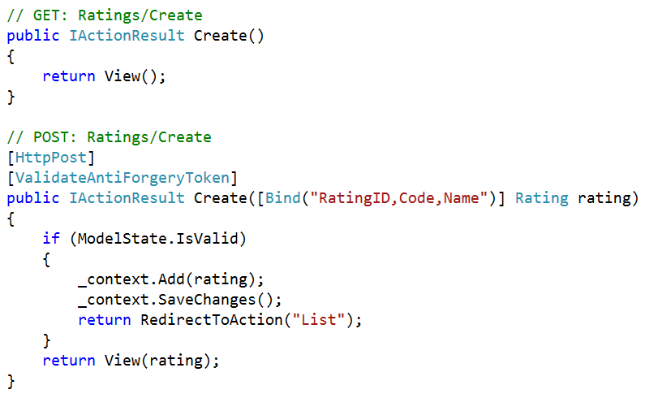
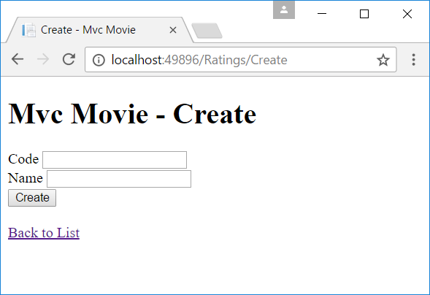
Create - get
Create (Get)
Create (Post)

Slide 11
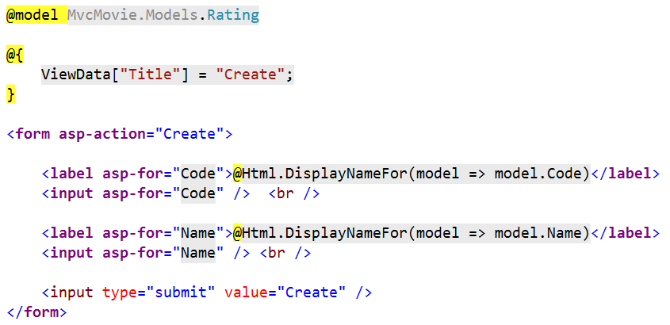
Create.cshtml

Slide 12
Form tag Helper (default = post)
<form asp-action="Create">
…
</form>
⇨Output in browser
<form action="/Ratings/Create" method="post">
…
<input name="__RequestVerificationToken" type="hidden"
value="CfDJ8K5uLJn…" />
</form>

Slide 13
Form tag Helper (get-method)
<form asp-action="Create" method="get">
…
</form>
⇨Output in browser
<form action="/Ratings/Create" method="get">
…
<input name="__RequestVerificationToken" type="hidden"
value="CfDJ8K5uLJn…" />
</form>

Slide 14
Label & input tag Helpers
<label asp-for="Code">
@Html.DisplayNameFor(model => model.Code)</label>
<input asp-for="Code" />
⇨Output in browser
<label for="Code">Code</label>
<input type="text" id="Code" name="Code" value="" />

Slide 15
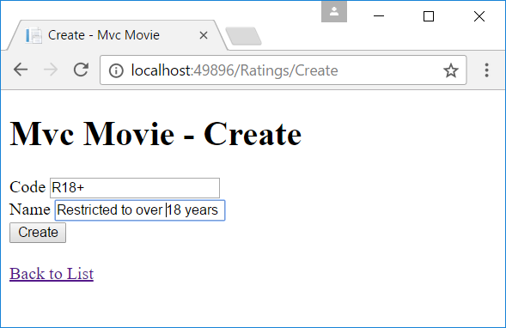
Create - Post

Slide 16
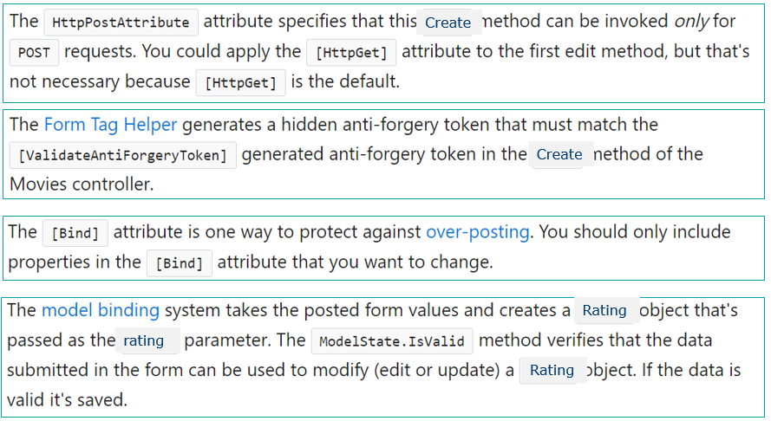
Create - Post

Slide 17
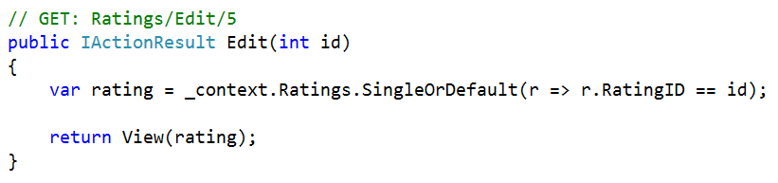
Edit - get
Edit (Get)

Slide 18
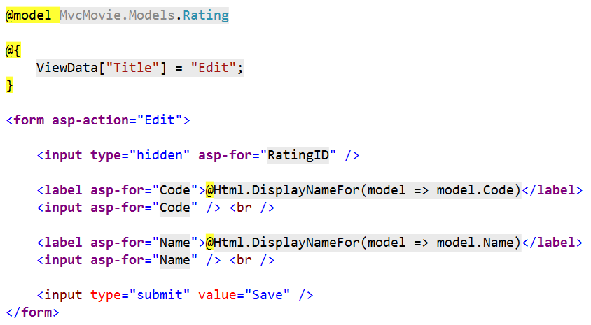
Edit.cshtml

Slide 19
Form tag Helper
<form asp-action="Edit">
…
</form>
⇨Output in browser
<form action="/Ratings/Edit/2" method="post">
…
<input name="__RequestVerificationToken" type="hidden"
value="CfDJ8K5uLJn…" />
</form>

Slide 20
Label & input tag Helpers
<label asp-for="Code">
@Html.DisplayNameFor(model => model.Code)</label>
<input asp-for="Code" />
⇨Output in browser (PG is the value of the Code property in the Model)
<label for="Code">Code</label>
<input type="text" id="Code" name="Code" value="PG" />

Slide 21
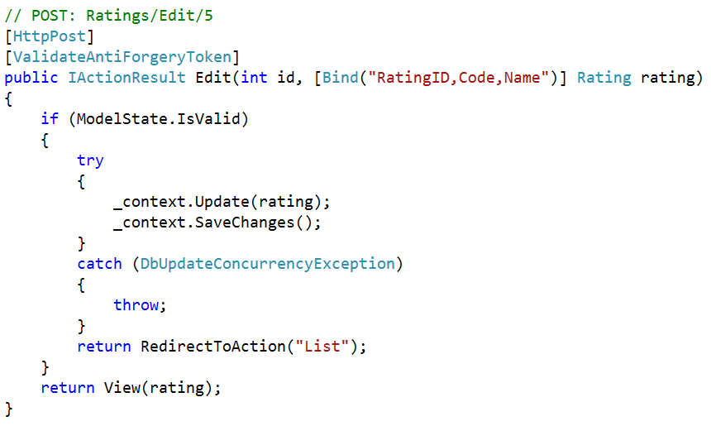
Edit - Post

Slide 22
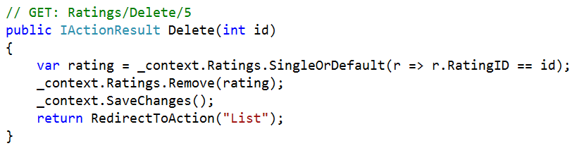
Delete - get

Slide 23
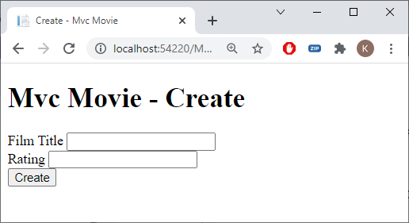
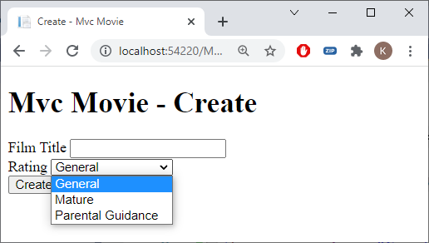
Create Movie (MoviesController.cs)
// GET: Movies/Create
public IActionResult Create()
{
return View();
}

Slide 24
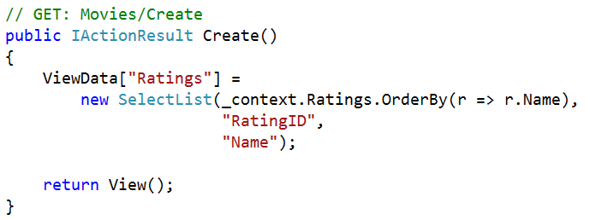
Selectlist (MOviesController.cs)
SelectList(items, dataValueField, dataTextField)
SelectList is passed to the view using ViewData, View Model approach is better (next lesson)
using Microsoft.AspNetCore.Mvc.Rendering;

Slide 25
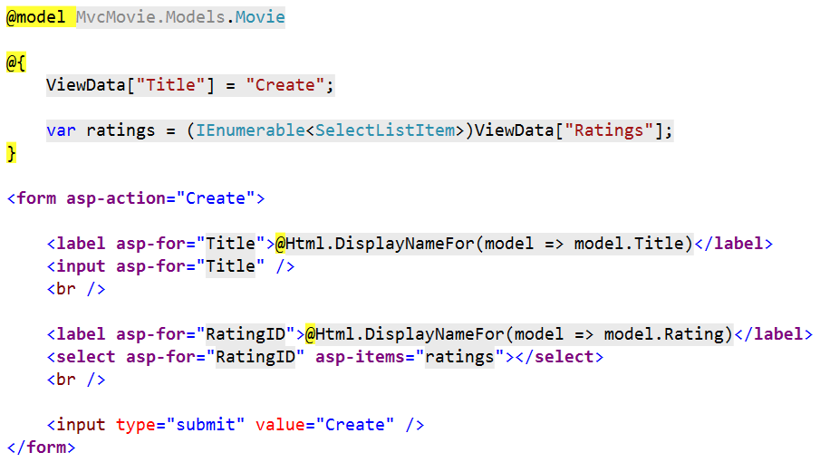
Create.cshtml

Slide 26
Select tag Helper
<label asp-for="RatingID">
@Html.DisplayNameFor(model => model.Rating)</label>
<select asp-for="RatingID" asp-items="ratings"></select>
⇨ Output in browser
<label for="RatingID">Rating</label>
<select id="RatingID" name="RatingID">
<option value="1">General</option>
<option value="3">Mature</option>
<option value="2">Parental Guidance</option>
<option value="1006">Restricted to over 18 years</option>
</select>

Slide 27
Radio tag Helper (exercise)
<input asp-for="Gender" type="radio" value="M" />Male
<input asp-for="Gender" type="radio" value="F" />Female
⇨ Output in browser
<input type="radio" value="M" id="Gender" name="Gender" />Male
<input type="radio" value="F" id="Gender" name="Gender" />Female

Slide 28
Exercise
MotoGP Part 4

